Slide 1
Power BI Training Day 5 : Session 3 30 mins Power BI Report Server

Slide 2
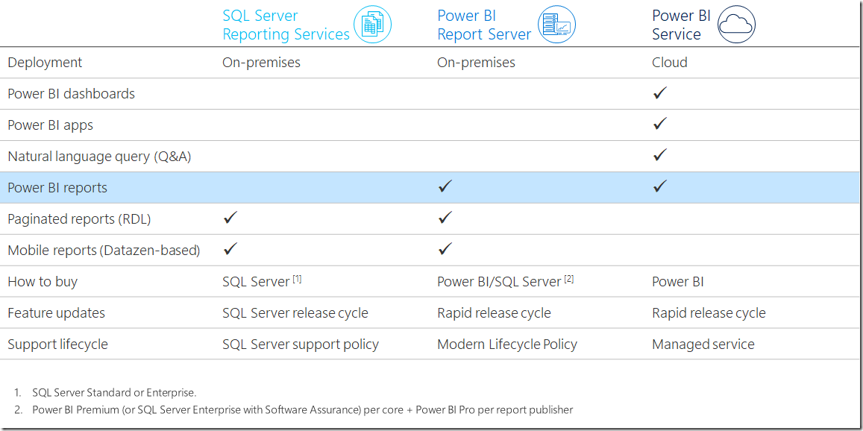

Slide 3
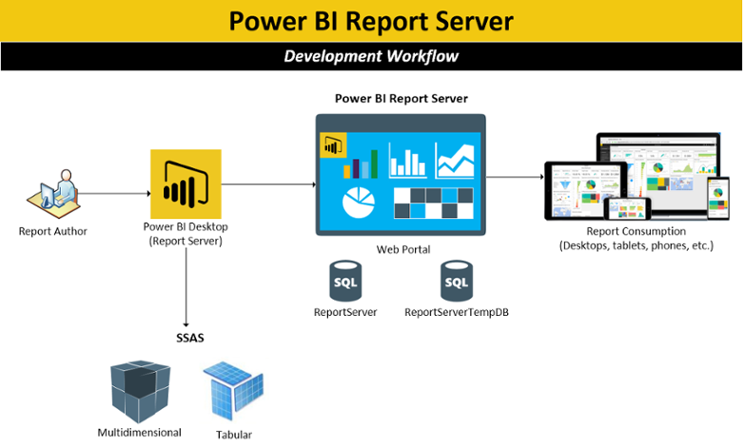

Slide 4
Check whitepaper
https://docs.microsoft.com/en-us/power-bi/report-server/capacity-planning
Could watch this on YouTube instead as the same presentation. With Riccardo Mutti
https://www.youtube.com/watch?v=L5O5J5qgZkk
See notes in folder to all URLS in Power BI Report Server documentation to walk through.
See file= “PBIRS online documentation”

Slide 5
Power BI Report Server Technical overview
David Moss, MVP Data Platform
@wottabyte

Slide 6

Today’s discussion
Overview
How to acquire
Power BI Report Server for the BI user
Power BI Report Server for the IT Pro
Scenarios
Summary

Slide 7
We’ve listened to feedback
Power BI reports and dashboards will be published to Microsoft cloud. It is very awesome approach as it saves all overhead of maintaining infrastructure. But there are cases where on-premise hosting is required - can we configure on-premise server to host Power BI reports just like SSRS reports?
Instead of publishing reports and dashboards to Microsoft cloud, can we published it into own private cloud?
I have trying to sell Power BI to my employer, but it got to a point we can't even talk more about off premise as an option. Due to compliance we can't publish anything to the cloud, period.
Just finished our SharePoint on prem 2016 and SQL 2016 deployments. Ability to publish BI to on prem is critical to us. Please enable this soon.
It is a very important feature to enable our users to have an integrated full feature experience in our on-prem Microsoft reporting platform!
It is very important that we have this on-premise feature developed. It is requested by many customers who are resistant to cloud solution.
On-premises hosting is much needed for clients with sensitive data.
Notes:
From https://ideas.powerbi.com/forums/265200-power-bi-ideas/suggestions/7948020-powerbi-reports-and-dashboard-on-premise-hosting

Slide 8

Overview
How to acquire
Report Server for the BI user
Report Server for the IT Pro
Scenarios
Summary

Slide 9
Power BI: experience your data Any data, any way, anywhere
Power BI: experience your data Any data, any way, anywhere
DATA
INSIGHTS
ACTIONS
Power BI reports
Get started quickly
Cloud
Live Dashboards
People
Natural Language Query
Custom Visualizations
On-premises
Power BI
Apps
PC
Mobile
HoloLens
Automation
Notes:
In helping organizations develop a data culture, Microsoft introduced Power BI, a business intelligence and analytics SaaS service that is easy to get started and simple to use allowing non-technical business users and business analysts to connect with their data, to get value out of their data in a way that was previously not possible.
It doesn’t matter what type of data you want or where it lives, Power BI allows you to connect to hundreds of data sources.
Power BI seamlessly integrates with Microsoft business apps like Dynamics 365 and Office 365, equipping users with insights directly within the Microsoft apps they use every day
And Power BI delivers unmatched, unique ways for users to experience their data with speed and agility: with features like -
Live dashboards that maintain a real time pulse on the business and provide critical insights…
Or Custom visuals that bring data to life and surface intelligence hidden in the sea of data…
Natural language query that enables users to simply ask questions of their data in an intuitive way…
Whether in the office or on-the-go, Power BI also provides anywhere access to insights with dashboards accessible via the desktop, web or across mobile devices.
Since first becoming generally available in July 2015, Power BI has continued to experience exponential growth – the service currently has more than five million subscribers worldwide. This explosive growth can largely be attributed to Microsoft’s “five minutes to wow” mantra, reflecting our relentless focus on enabling users across roles, disciplines and industries to sign up for Power BI within five seconds and get business value by drawing insights from their data within five minutes.

Slide 10
Power BI: extending on-premises capabilities
Power BI: extending on-premises capabilities
Power BI reports
Power BI reports
Get started quickly
SSRS reports
Live Dashboards
Custom
Visualizations
Natural Language Query
Custom Visualizations
Power BI
Power BI Report Server
Notes:
Microsoft is now taking the next step in its commitment to empower people with access to critical intelligence: by extending Power BI capabilities on-premises
We are introducing Power BI Report Server that allows the deployment and distribution of interactive Power BI reports – and traditional paginated reports – completely within the boundaries of your organization’s firewall.

Slide 11




Power BI Report Server Self-service BI and enterprise reporting in one solution
Power BI reports
Keep Power BI reports on-premises
SSRS reports
Custom
Visualizations
Compatible with SSRS
Power BI Report Server
Move to the cloud on your terms
Notes:
Power BI Report Server gives your users access to data and insights and gives you the enterprise reporting capabilities of SQL Server Reporting Services—all packaged in a modern, on-premises solution.
It enables you to keep fully interactive Power BI Reports on-premises and make them available to users in your organization
And because Power BI Report Server is built on the proven SQL Server Report Services technology, it is fully compatible with SSRS. So, you can take advantage of the full complement of SSRS capabilities when you deploy Power BI Report Server.
If you have an existing SSRS implementation, you can still take advantage of the additional capabilities of Power BI Report Server and we will help you standardize on Power BI Report Server as the single on-premises reporting solution, by providing you with necessary tools to migrate your existing SSRS reports to Power BI Report Server.
An on-premises reporting solution means you have the flexibility to keep reports and data behind your firewall and comply with your specific governance needs. At the same time, we want to provide your organization the flexibility to move your reporting solution to the cloud - at your pace. With Power BI Report Server, you can build on your on-premises reporting infrastructure, knowing it’s part of a comprehensive, cloud-ready solution. Use Power BI Report Server today and when you are ready to start moving to the cloud, Power BI Report Server maintains compatibility with Power BI to support a natural transition. And because the two products work together, you now have the flexibility to develop a hybrid BI solution by keeping some BI assets on-premises with Power BI Report Server, at the same time giving your users the true experience and benefits of modern self-service BI with Power BI.

Slide 12

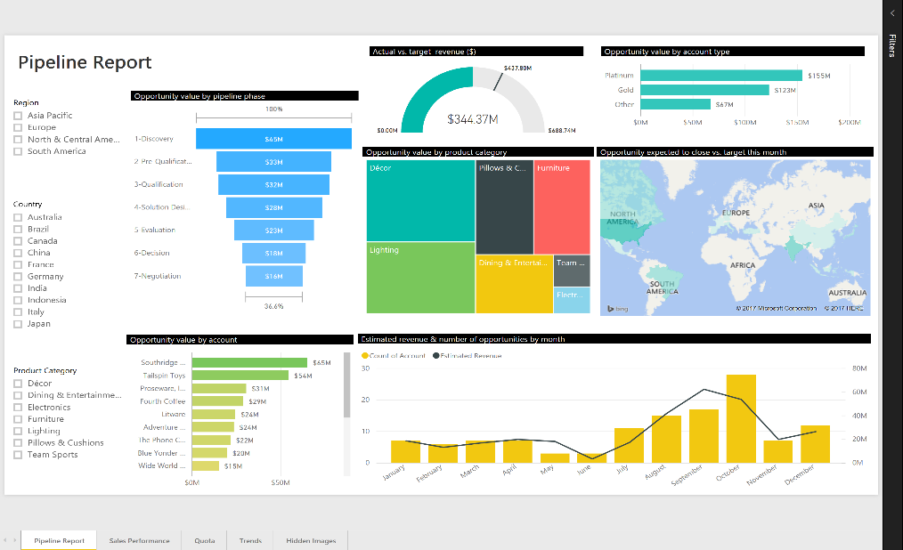
Keep Power BI reports on-premises Fully interactive reports to visualize your data and gain insights
Interactive Power BI Reports
TAG
Explore data across multiple visualizations
Drill through to underlying reports
Apply filters at a visual, page, or report level
Notes:
One of the key capabilities of Power BI Report Server is that it enables you to distribute fully interactive Power BI Reports to your users on-premises.
Your business users can author beautiful Power BI Reports in minutes with the included Power BI Desktop. Power BI Desktop provides a freeform drag and drop canvas and powerful report creation tools. Users in your organization can then publish these reports directly to your Power BI Report Server and make them available to an even wider audience on-premises.
You need to note, that the user needs to be a Power BI Pro user to be able to publish Power BI Reports to Power BI Report Server. Consuming Power BI Reports published to Power BI Report Server does not need user specific license.
Your users can consume these reports in modern web browsers and mobile apps and interactively explore data across multiple visualizations with built-in cross filtering. They can quickly discover patterns as they explore a single unified view of linked, interactive visualizations. The ability to drill through visuals to underlying reports, enables users to explore data in more detail. Power BI Reports also enable users to dynamically apply filters at a single visual or a page or at the report level. You can thus empower your users to gain critical insights instantly and make informed decisions.

Slide 13

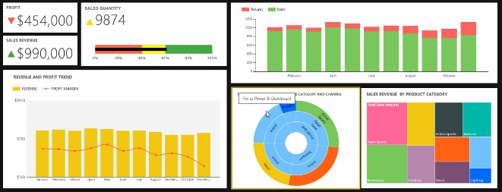
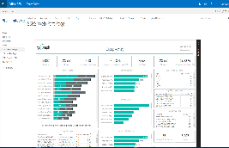

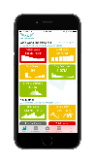
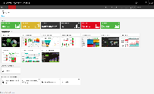
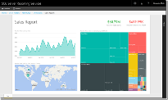

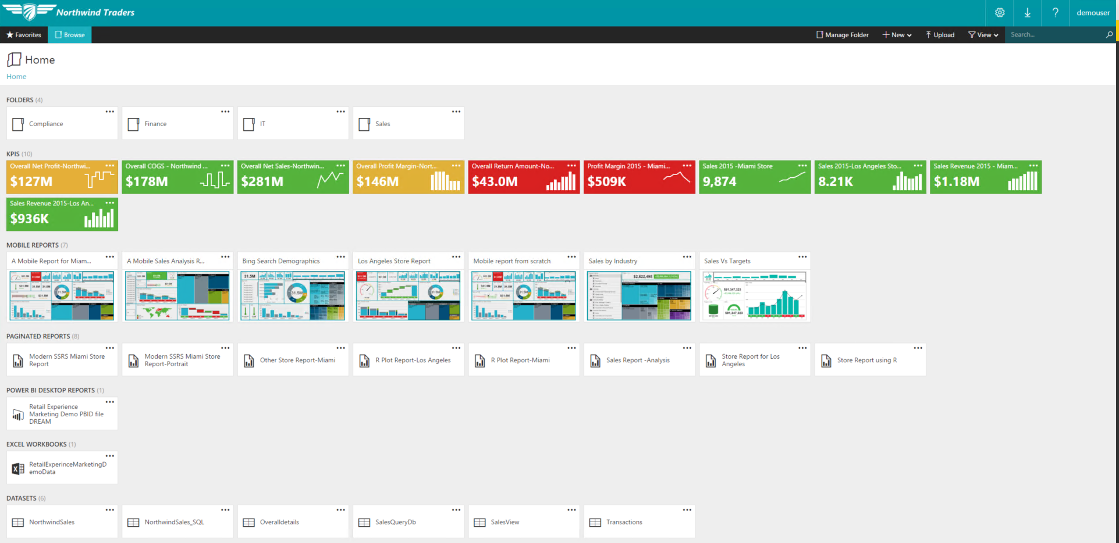
Compatible with SSRS Built on proven SQL Server Reporting Services technology
Power BI Report Server
Self service BI and enterprise reporting in one solution
Publish SSRS reports Create and publish precisely-formatted, paginated, modern reports
Consume in multiple ways Modern browsers, mobile app or embed into apps
Benefit from an enterprise-ready solution Manage permissions, enable security, set up alerts, and access reports in one modern web portal
Notes:
In addition to Power BI Reports, Power BI Report Server supports enterprise reporting through SSRS operational reports. You can create precisely formatted, operational reports optimized for document generation and printing, with page headers, footers and with modern charts and gauge styles – all with familiar tools such as Report Builder and Report Designer in SQL Server Data Tools.
Your users can then consume these paginated reports through modern browsers and Power BI Mobile App, or you can embed these reports in Sharepoint or your own applications. You can thus enable your users to consume these reports in multiple ways to meet your business needs.
And because Power BI Report Server is built on SQL Server Reporting Services technology, you benefit from a proven, enterprise-ready reporting engine. You can manage all your reports through one modern web portal and provide secured access to reports and KPIs in one place.
Power BI Report Server empowers your business users to set up personalized alerts and subscriptions and at the same time provides you the control to manage permissions and security to meet your compliance needs.
You’ll also be able to confidently scale to thousands of users, because Power BI Report Server is based on a proven, enterprise-grade platform.

Slide 14


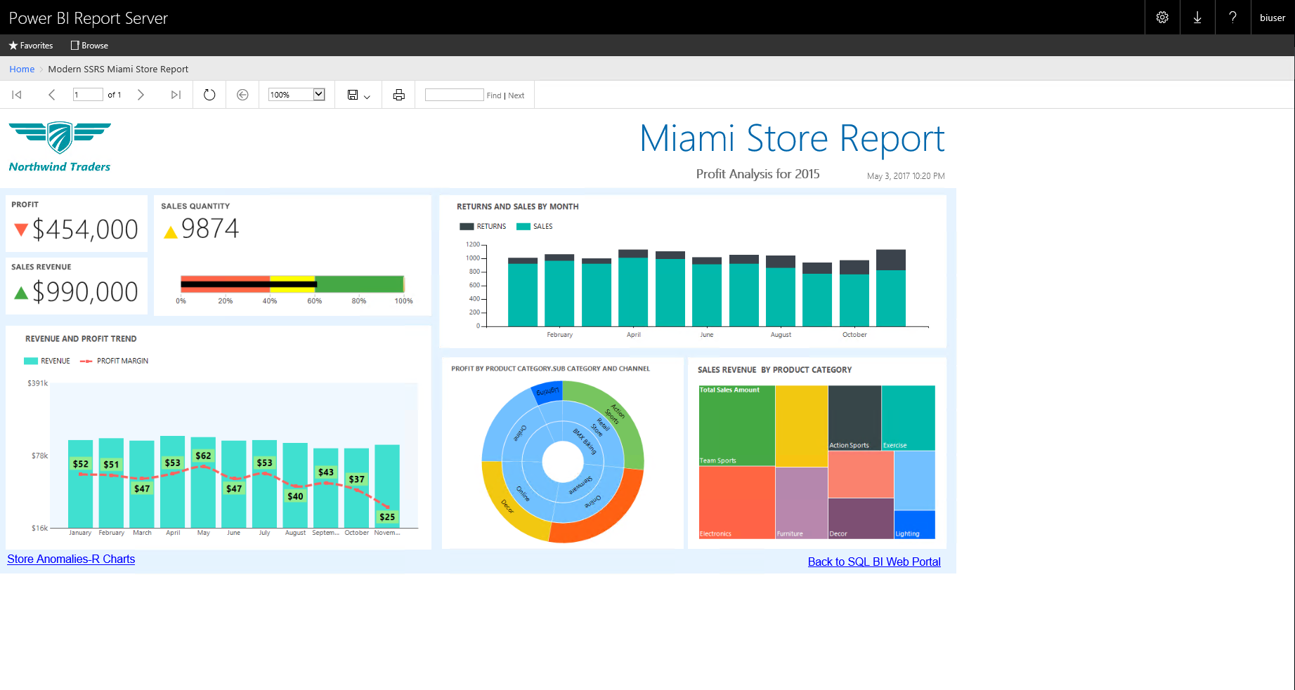
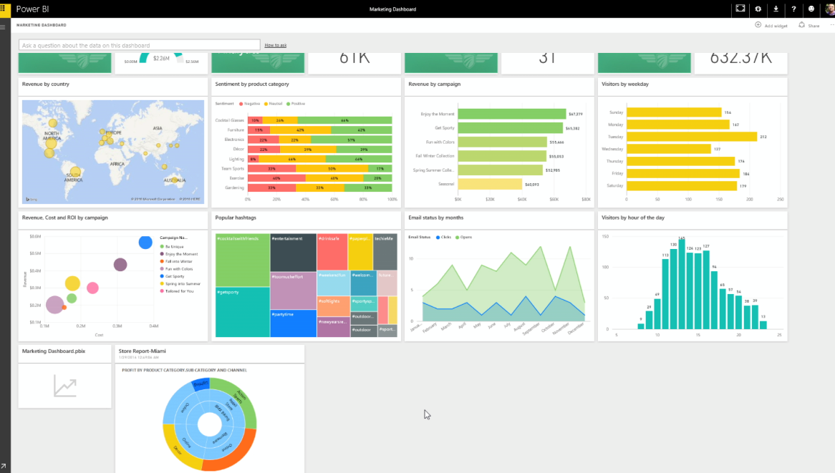
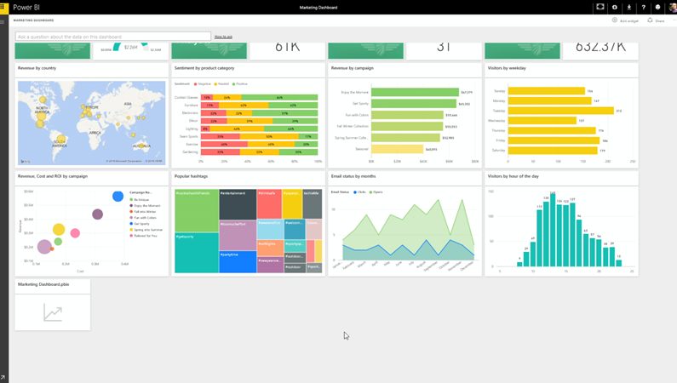
Get more from reporting investments Extend on-premises reports to the cloud
Power BI Report Server
Take your on-premises investments to the cloud
Power BI reports
Power BI reports
SSRS reports
Get started quickly
Custom
Visualizations
Live Dashboards
Natural Language Query
Custom Visualizations
Power BI Report Server
Power BI

Slide 15

Overview
How to acquire
Report Server for the BI user
Report Server for the IT Pro
Scenarios
Summary

Slide 16
How to acquire Power BI Report Server
Power BI Premium
SQL Server
Power BI Premium includes rights to concurrently deploy Power BI Report Server on-premises
Customers with SQL EE SA also have access to Power BI Report Server as a SA benefit
* Power BI Pro license required to publish Power BI Reports to Power BI Report Server
Notes:
Getting Power BI Report Server is relatively simple.
It is available as part of Power BI Premium. Power BI Premium includes rights to concurrently deploy Power BI Report Server to equivalent number of cores on-premises.
Power BI Report Server is also available through SQL Server licenses. Customers with SQL Server Enterprise Edition with active SA, also have access to Power BI Report Server as a SA benefit.
And as noted, a Power BI Pro license is required to publish Power BI Reports to the report server

Slide 17
Power BI Premium
Flexibility to license by capacity
Greater scale and performance
Dedicated
resources
in the cloud
Extending on-premises capabilities
Power BI Premium
Embedded
analytics
Notes:
Let’s take a quick look at what is Power BI Premium.
An add-on to Power BI Pro, Power BI Premium provides dedicated resources in the Microsoft cloud for your organization’s exclusive use.
Power BI Premium offers the flexibility to license by capacity, helping organizations empower a broader set of people with access to critical intelligence without requiring per user licensing
Power BI Premium provides greater scale and performance—with dedicated hardware resources in the Microsoft cloud—fully managed by Microsoft—for your organization’s exclusive use.
And as we have previously seen, Power BI Premium extends on-premises capabilities by including Power BI Report Server
With the release of Power BI Premium, we are converging Power BI Embedded with the Power BI service, providing a unified platform for both SaaS and PaaS that delivers one API surface and a consistent set of capabilities.

Slide 18
Overview
How to acquire
Report Server for the BI user
Report Server for the IT Pro
Scenarios
Summary

Slide 19


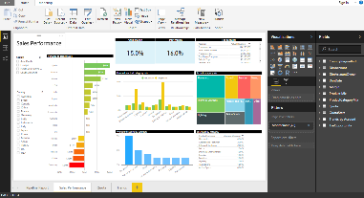
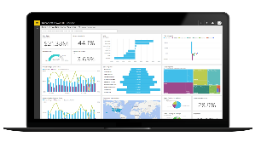
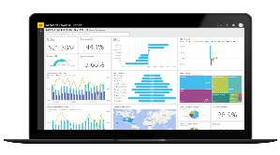
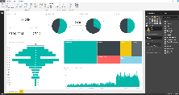
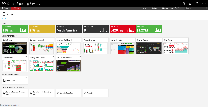
Power BI Report Server
Create
Publish
Consume
Create compelling interactive
Power BI reports
Publish seamlessly to Power BI Report Server
Consume in multiple ways
to meet your business needs
Notes:
Rich report authoring tool with direct publishing to Power BI service and Power BI Report Server
Connect to Analysis Services build fully interactive Power BI Reports
Additional data sources (Power Query)*
Publish quickly and mange with ease
ONE SET OF MOBILE APP for Power BI reports and dashboards hosted on the service or on the PBI Report Server
WEB PORTAL
Embed in your application

Slide 20
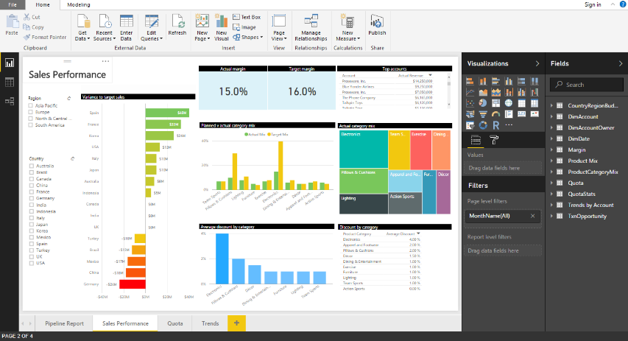
Create compelling interactive reports
Using Power BI Desktop
Connect to Analysis Services models (Tabular or Multidimensional)
Connect directly to additional data sources in a future update
Explore and visualize your data on a freeform canvas with a variety of built-in and custom visuals
Notes:
Call out specific version of Power BI Desktop
Rich report authoring tool with direct publishing to Power BI service and Power BI Report Server
Connect to Analysis Services build fully interactive Power BI Reports and in the future connect to Power BI data sources

Slide 21
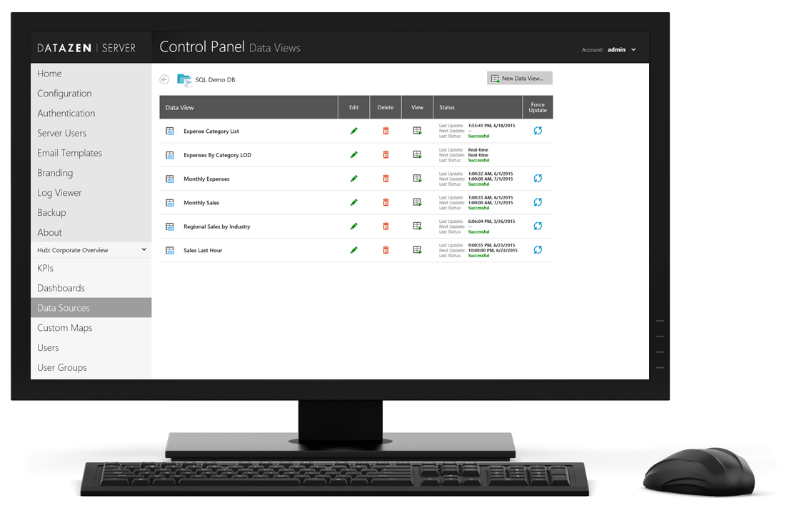
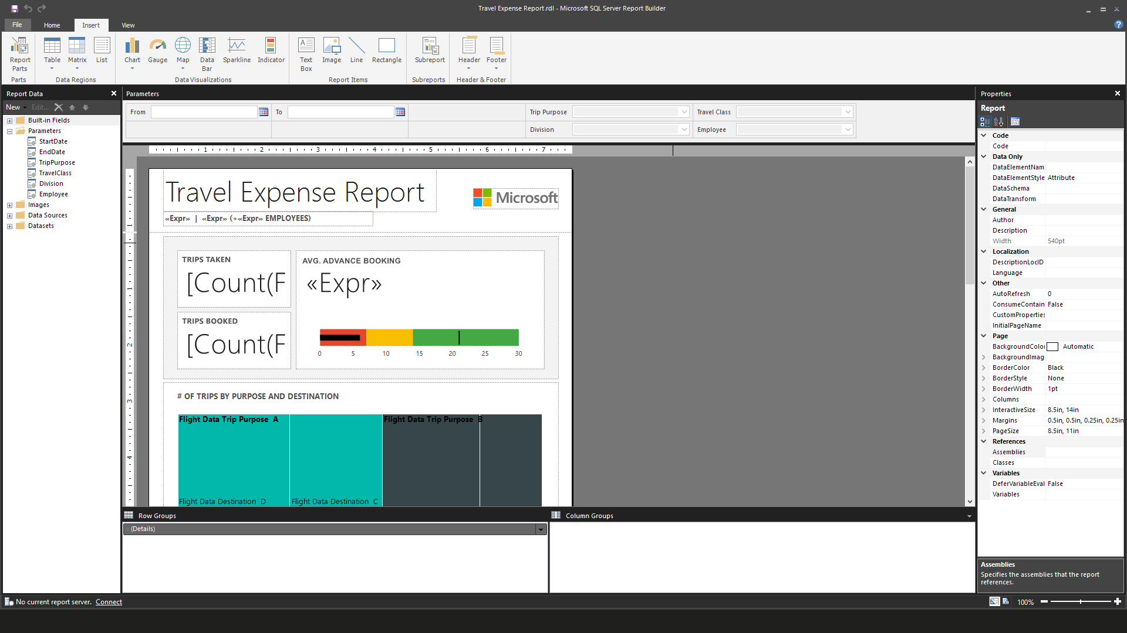
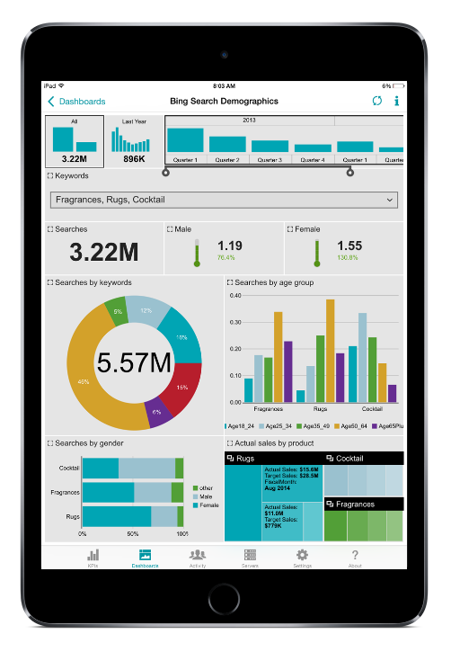
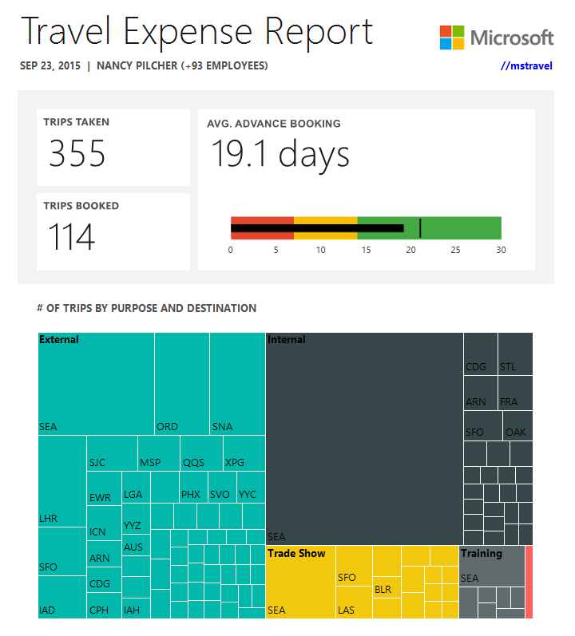
Create modern paginated reports Design beautiful documents quickly and easily
Precisely formatted operational reports
Optimized for document generation and printing
Page headers, footers, and page breaks
Modern chart and gauge styles
Visual Studio 2015 support
Plugin-free printing
Notes:
Key Points:
SQL Server Reporting Services allows report authors to easily create modern, precisely paginated and formatted reports
Talk track:
Modern chart and gauge styles
Additional chart types to visualize dense hierarchical data with additional chart types such as sunburst and tree maps.
Modern report design tool Report authors can design reports in an updated version of Report Builder sporting a modern look and feel, while those who prefer a Visual Studio-integrated report design environment can now develop reports in Visual Studio 2015 using SQL Server Data Tools (SSDT).
Plugin-free printing Print from modern browsers without the need to install an ActiveX control
Notes (delete later)
"Optimized for document generation and printing", "Page headers/footers and page breaks", "Precise layout and fine-grain formatting to address complex operational reporting requirements,

Slide 22


Pin report items to Power BI dashboards Get more from existing Reporting Services investments
Monitor the most important metrics and trends in one place
Pin charts, gauges, maps, and images as tiles to Power BI dashboards
Drill through to source reports
Refresh tiles on a schedule
Notes:
Key Points:
View most important metrics in one place by pinning Reporting Services paginated report items to your Power BI dashboard.
Talk track:
In addition to using Reporting Services on-premises, you can now use Power BI dashboards to monitor the metrics and trends that matter to you. You can harness your on-premises reporting investments and extend it to the cloud. Business users can pin paginated report items to their Power BI dashboards, enabling them to monitor the most important metrics and trends at a glance in one place.
[click] to show sunburst chart added to Power BI Dashboards

Slide 23

Pin report items to Power BI dashboards Get more from existing Reporting Services investments
Monitor the most important metrics and trends in one place
Pin charts, gauges, maps, and images as tiles to Power BI dashboards
Drill through to source reports
Refresh tiles on a schedule
Notes:
Key Points:
View most important metrics in one place by pinning Reporting Services paginated report items to your Power BI dashboard.
Talk track:
The original reports remain one click away, ensuring that people can drill through to the details when necessary.

Slide 24
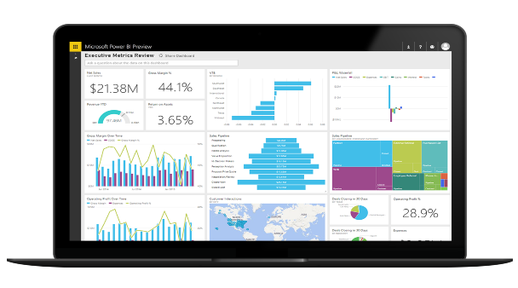
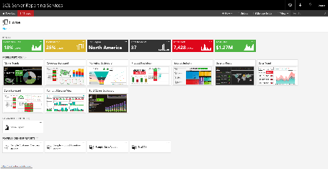

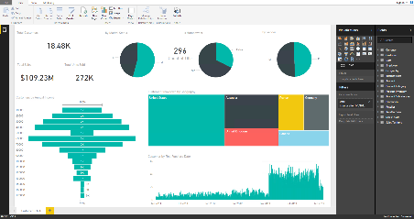
Publish and manage with ease
Publish to Power BI Report Server
Power BI Report Server
Organize and manage access to reports
Update reports and republish
Power BI Desktop
Notes:
Create reports in Power BI Desktop (Pro License)
Connect “live” to Analysis Service
Publish to Power BI Report Server
View and interact in your web browser or Power BI Mobile

Slide 25

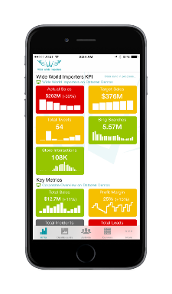

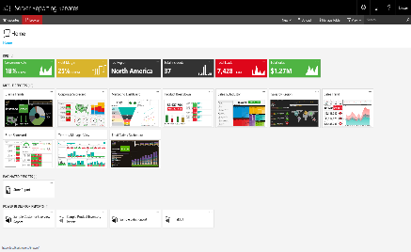
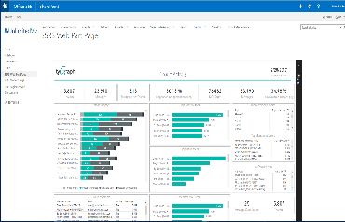
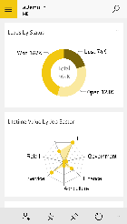

Consume in multiple ways to meet business needs
Mobile Apps
Web Portal
Embedded In Your Apps
Windows Phone App
Android App
iOS App
Consume with ease via Power BI Report Server web portal
Easy to embed into apps
</>
Notes:
Create reports in Power BI Desktop
Connect “live” to Analysis Service
Publish to Power BI Report Server
View and interact in your web browser or Power BI Mobile
Pin paginated report items to Power BI dashboards

Slide 26

Embed in an application
Easy to embed into apps
<iframe src=“https://server/reports/powerbi/ReportName?rs:Embed=true” width=“800px” height=“600px”></iframe>

Slide 27
Overview
How to acquire
Report Server for the BI user
Report Server for the IT Pro
Scenarios
Summary

Slide 28
Power BI Report Server for the IT Pro
Installation
Migration
Scalability
Security
Lifecycle
Easy standalone install and setup
Straightforward migration of reports from SQL Server Reporting Services
Proven scale out capabilities
Enterprise grade security with multifactor authentication
Latest and greatest features with frequent releases
Notes:
Increased tools release cadence to match service

Slide 29
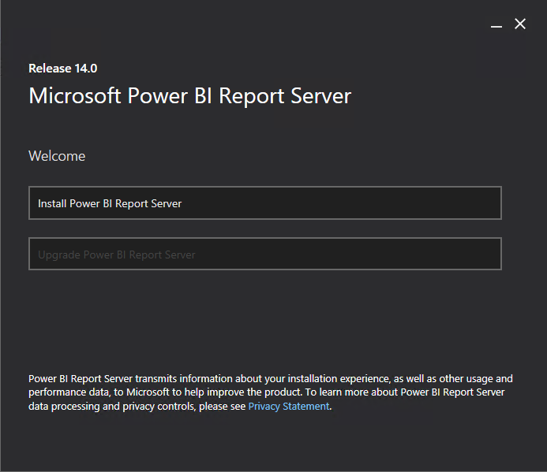
Install in minutes
Easy standalone installation and set up
Zero impact on database ETL processes
Requirements
Windows Server 2012+
SQL Server Database Engine (2008 SP4+)
SQL Server Analysis Services (2012
Notes:
With purchase of Power BI Premium, you will get a SQL Server license exclusively to use for Power BI Report Server if you need one
Add link here for “to learn more” in May

Slide 30
Migrate from SSRS (Native mode)
Three Step Migration
White paper coming soon!
Clone the database hosting all your SSRS reports
SSRS
Power BI Report Server
Set up Power BI Report Server using the installation wizard
Copy/Move
Connect Power BI Report Server to the cloned database via Report Server Configuration Manager
SSRS Database
Power BI Report Server Database
Notes:
Add note on what SSRS version required
You can migrate all existing reports from SSRS. It’s easy for SSRS set up in native mode.
Encryption key

Slide 31


Migrate from SSRS (SharePoint-integrated mode)
Migrate Reports
SSRS
Power BI Report Server
SharePoint
Sample Script
rs.exe
-i ssrs_migration.rss -e Mgmt2010
-s http://SourceServer/_vti_bin/reportserver
-v st="sites/bi" -v f="Shared Documents“
-u Domain\User1 -p Password
-v ts=http://TargetServer/reportserver
-v tu="Domain\User" -v tp="Password"
Notes:
Add note on what SSRS version required
You can migrate all existing reports from SSRS. It’s easy for SSRS set up in native mode.
Encryption key

Slide 32
Scale-out Power BI Report Server
Report Server
Clients
Load Balancer
Report Server Database
Report Server
Notes:
Key Points(s)
Scale out Power BI Report Server the same way as SSRS.
https://msdn.microsoft.com/en-us/library/ms181357

Slide 33
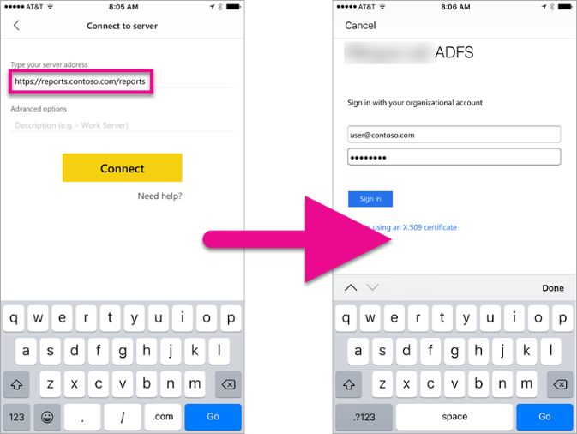
Security via WAP and ADFS
Internet
Corporate Network
Client Devices
AD DS
AD FS
Firewall
Web Application Proxy
Firewall
Power BI Report Server
Notes:
Active Directory Federation Services (ADFS) is a standards based service that provides a secure single sign on, Web SSO to federated partners outside your organization, which enable them to access Power BI Report Server web portal.

Slide 34
Modern Lifecycle Policy
Deploy updates on your terms and timing
Year 1
Year 2
Frequent releases (planning for approximately 3 per year)
Security & Critical Updates
Security Updates (Only)
Release 1
Critical and security updates until next release
Security & Critical Updates
Security Updates (Only)
Release 2
Security updates continue for the remainder of the 12 month release lifespan
Security & Critical Updates
Security Updates (Only)
Release 3
New Release
Support Ends
Notes:
Key Point(s)
Frequent releases (planning for approximately 3 per year)
Critical and security updates until next release
Security updates continue for the remainder of the 12 month release lifespan
Upgrade flexibility – upgrade to the next release as soon as it’s available to get the latest updates, wait until you are ready or skip to the next release.
Talk Track
Power BI Report Server will follow Microsoft’s modern lifecycle policy. That means you get the latest and greatest features with frequent releases. We are planning for approximately three releases per year, with supporting critical and security updates until the next release. You have the flexibility to upgrade to the next feature release as soon as its available to get the latest updates, or wait until you are ready or even skip a release entirely within the twelve-month release lifespan.
Modern and Fixed policies
https://support.microsoft.com/en-us/help/4014109/announcing-modern-and-fixed-policies
Modern Lifecycle Policy
https://support.microsoft.com/en-us/help/30881/modern-lifecycle-policy

Slide 35

Updating Power BI Desktop + Report Server
Power BI Report Server and Power BI Desktop release concurrently
Power BI Report Server
Must be upgraded simultaneously
Upgrade
Upgrade
IT Pro
Power BI Desktop

Slide 36
Overview
How to acquire
Report Server for the BI user
Report Server for the IT Pro
Scenarios
Summary

Slide 37

Scenarios for all reporting products
My organization wants an on-premises solution to generate precisely-formatted operational reports
My organization wants an on-premises solution for self-service BI as well as operational reporting
My organization wants a managed Software-as-a-Service (SaaS) solution for next-generation, business user-led BI, complete with Apps, real-time Dashboards, Q&A, and more
SQL Server Reporting Services
Power BI Report Server
Power BI service

Slide 38


Compare reporting options
 | SQL Server Reporting Services | Power BI Report Server | Power BI Service
Deployment | On-premises | On-premises | Cloud
Power BI reports |  | ✓ | ✓
Real-time Power BI Dashboards |  |  | ✓
Content packs |  |  | ✓
Q&A |  |  | ✓
Quick Insight |  |  | ✓
Built-in embedded analytics services |  | Planned | ✓
Paginated reports | ✓ | ✓
Mobile BI | ✓ | ✓ | ✓
Lifecycle | Fixed Lifecycle Policy | Modern Lifecycle Policy | Fully Managed Service
Notes:
Details on mobile BI (SSRS Datazen still supported etc)
Discussion of features of Power BI Service that aren’t available in Power BI Report Server
Modern and Fixed policies
https://support.microsoft.com/en-us/help/4014109/announcing-modern-and-fixed-policies

Slide 39
Overview
How to acquire
Report Server for the BI user
Report Server for the IT Pro
Scenarios
Summary

Slide 40

It’s easy to get started…
PowerBI.com
Notes:
Key points
Go to Powerbi.com to get started.
Learn more about Power BI Premium from the Powerbi.com site
TALK TRACK
If you want to learn more about Power BI Premium, simply go to the Power site to learn more.

Slide 41
Learn more
For Discussion:
Need more info on how to buy and where to get more info
Once FAQ doc produced decide: include FAQ link or separate slide with FAQ content?
Learn
Power BI Documentation and FAQs for more information
Try
Power BI Premium today
Deploy
BI solutions faster using Solution Templates and/or with a partner

Slide 43
Appendix

Slide 44

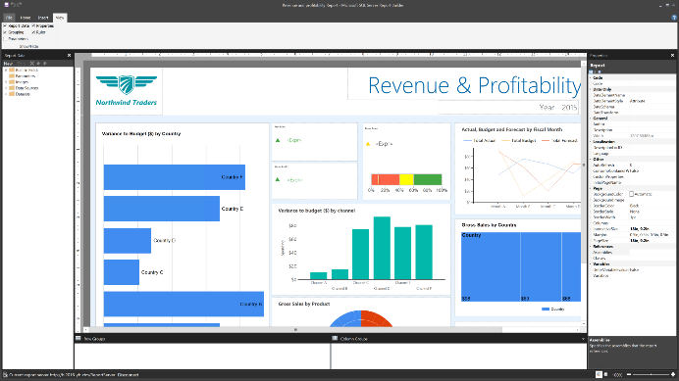
Proven reporting platform
Works with what you have
Create business insights and reports with familiar tools
Secured data sets and reports
Provide IT-managed, personalized access to data sets and reports
Scale to thousands of users
Design a highly available solution knowing it can scale as your needs change
Deploy your way—on-premises, or cloud
Run on-premises or in Azure Virtual Machines

Slide 45

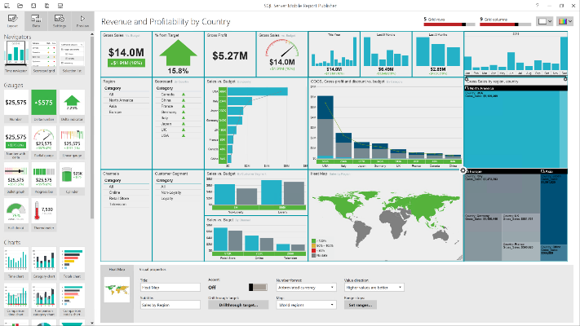
Transform data into insights across the organization
Create beautiful visualizations
Provide easy to access and easy to understand reports
Customize to suit your business users
Present tailored reports and custom visualizations
Create precisely paginated and formatted reports to enable easy consumption
Design responsive mobile reports
Deliver engaging reports that adjust automatically to tablets and phones

Slide 46
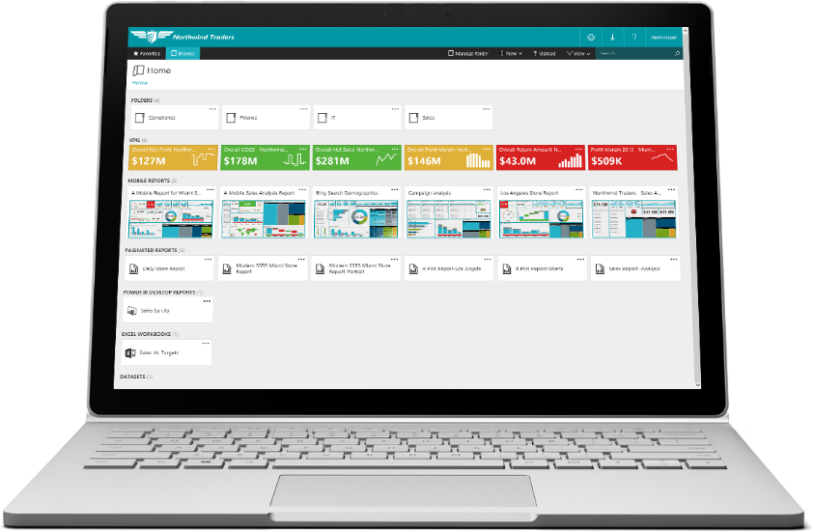
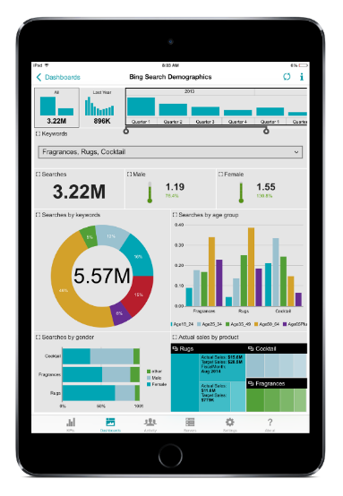
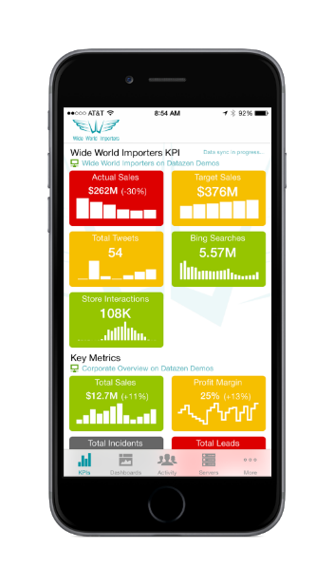
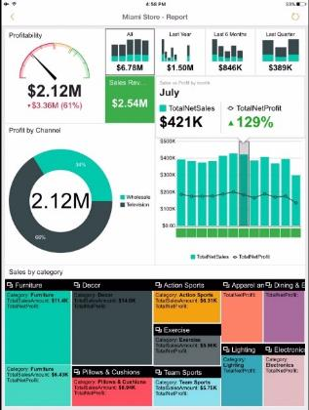
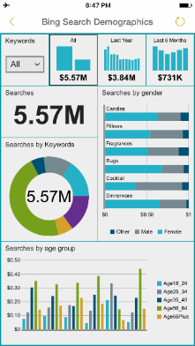
Empower business users with the right insights
Store all your reports in one place
Provide access to paginated reports, KPIs and mobile reports on a single, modern web portal
Deliver reports in the right format
Publish reports to the right people with a variety of reporting formats
Keep business users up-to-date with mobile reports
Deliver latest reports and insights that business users can access from virtually anywhere

Slide 47

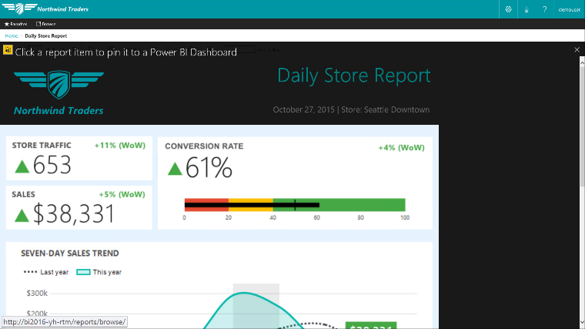
Benefit from on-premises BI assets
Pin report items to Power BI dashboards
Monitor the most important metrics and trends in one place
Pin charts, gauges, maps, and images as tiles to Power BI dashboards
Drill through to source reports
Refresh tiles on a schedule

Slide 48

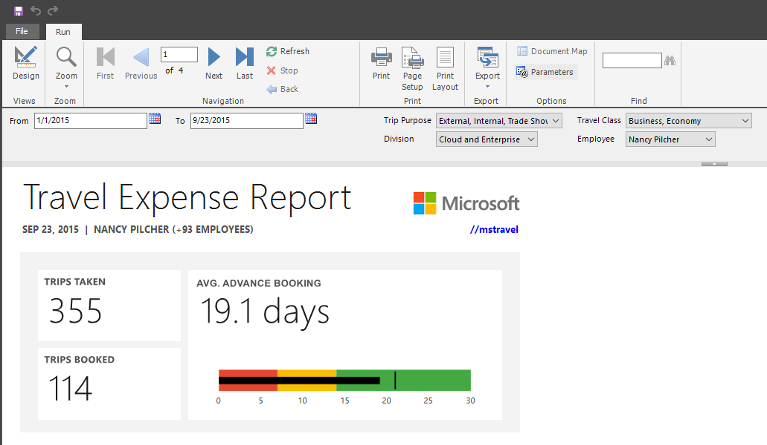
Customizable parameter layout Position report parameters the way you want
Position parameters across more than two columns
Choose the position of each parameter
Create space between groups of parameters
Notes:
Key Points:
SQL Server 2016 Reporting Services supports customizable parameter layouts.
Talk track:
Customizable parameter layout Report authors can have more control over the parameter layouts, incl. the ability to have multiple parameter columns and better control over the position of the parameters. Using the design surface in Report Builder, you can drag a parameter to a specific column and row in the parameter pane. You can add and remove columns to change the layout of the pane.

Slide 49
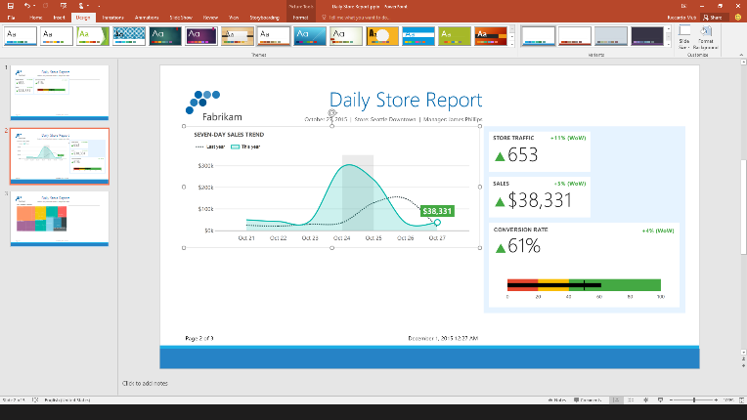
Export to PowerPoint Generate presentations from paginated reports
Generate slides including all report content in seconds
Move and resize individual objects
Export manually, schedule for email delivery, or generate programmatically
Notes:
Key Points:
Generate presentations from paginated reports – export you entire report to a set of PowerPoint slides.
Talk track:
Export to PowerPoint You can already export reports to Microsoft Word and Excel as well as to other formats such as PDF, but when it comes to presenting information to an audience, PowerPoint is often the tool of choice. In SQL Server 2016 we are adding PowerPoint to the list of built-in export formats. You can now export an entire report to a set of PowerPoint slides. After exporting, you can further modify the generated slides as needed. Simply move, resize and copy-and-paste individual charts, gauge panels, and maps. You can also edit and format heading text or add you own.

Slide 50

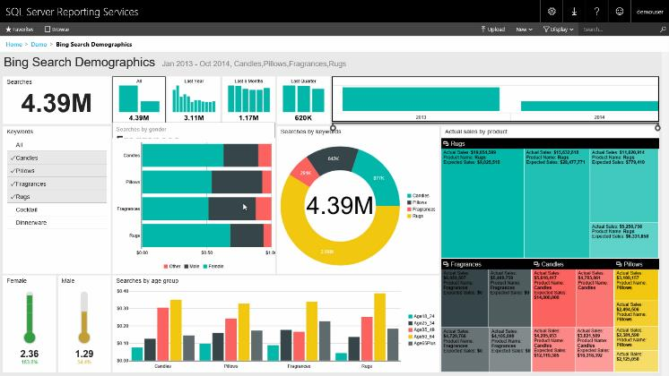
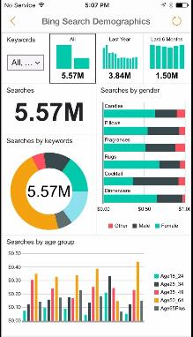
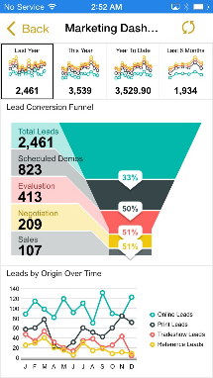
Consume mobile reports Native apps for all major mobile platforms
One mobile app for Power BI and SSRS mobile reports
Native mobile experience optimized for touch
Keep data up-to-date with real-time query or scheduled data refresh
Interact with mobile reports even when disconnected
Windows
iOS
Android
HTML5
Notes:
Key points:
Mobile reports dynamically adjust the content to fit your screen (or browser window). You never see content scrolled out of view or flowing onto a different page. While you can view these reports on your PC as well, they're really optimized for mobile devices.:
Talk track:
You only need one mobile app to access Power BI and SSRS mobile reports. Power BI apps are available for all major mobile platforms.
Connect to your on-premises SSRS server and view your KPIs and mobile reports
In addition to access via mobile devices you can also access your data via HTML rendering from your browser.
The Power BI app to view Reporting Services mobile reports and KPIs is available in preview for iOS and Android here:
For iPhone: https://itunes.apple.com/us/app/microsoft-power-bi/id929738808?mt=8
For Android: https://play.google.com/store/apps/details?id=com.microsoft.powerbim

Slide 51
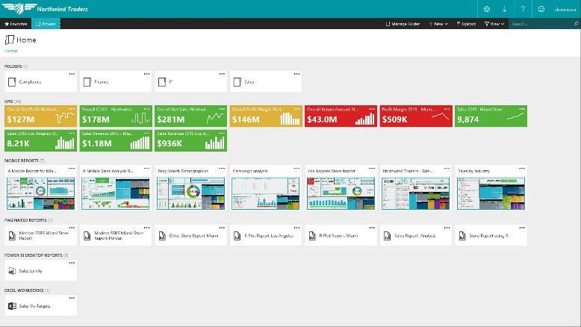
New, modern web portal for reports Consume paginated and mobile reports in one place
Access KPIs and both types of reports in one web portal
Upload Power BI Desktop files and Excel spreadsheets
Apply custom branding
Designed for modern browsers
Built on HTML5 technology
Notes:
Key Points:
View all your reports – both mobile and paginated reports – in one place.
Talk track:
Access KPIs, mobile and paginated reports in one web portal
Upload your Power BI Desktop files and Excel spreadsheets for easy access
Make it your own by applying a custom brand package to the web portal and the mobile report.
Designed for modern browsers and build from the ground up on HTML5.

Slide 52
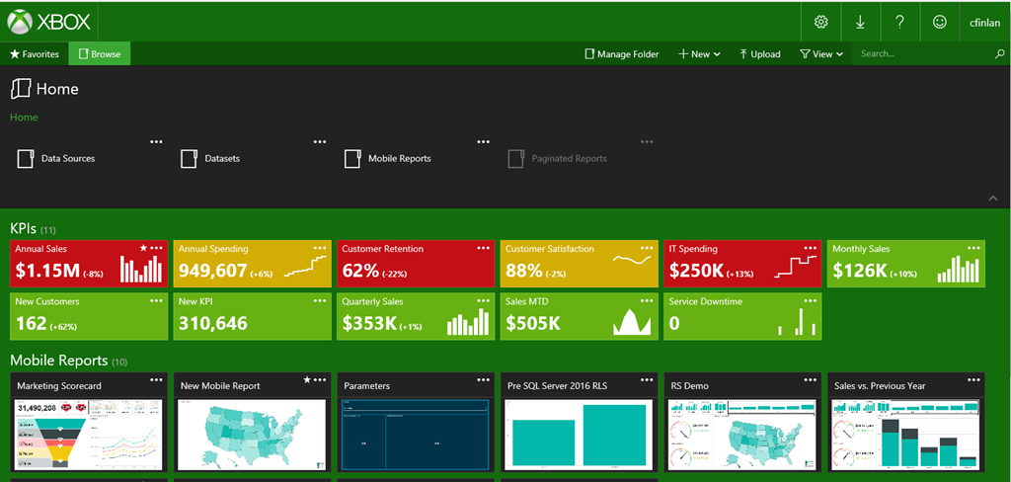
Custom Branding
The web portal supports custom branding, allowing the customization of:
Logo
Web portal colors, and
A mobile report theme

Slide 53
Check whitepaper
https://docs.microsoft.com/en-us/power-bi/report-server/capacity-planning
Blog posting odf Install & Configure steps of PBIRS April 2018
https://blog.devoworx.net/2018/04/26/install-and-configure-power-bi-report-server/

Slide 54
Power BI Training Day 5 : Session 3 30 mins Power BI Report Server END

